Slide 1
Adaptive Clocking Techniques for SoC Supply Droop Response in Predictive 7nm CMOS
Dan Fritchman, Wahid Rahman
EE241B Final Project
UC Berkeley
May 4, 2020

Slide 2
Overview
Motivation
Adaptive clocking schemes
PLL-based adaptive clocking
Adaptive Clock Distribution (ACD)
PLL-based adaptive clocking in ASAP7
Simulation results
Summary

Slide 3
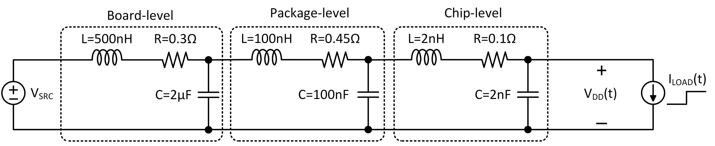
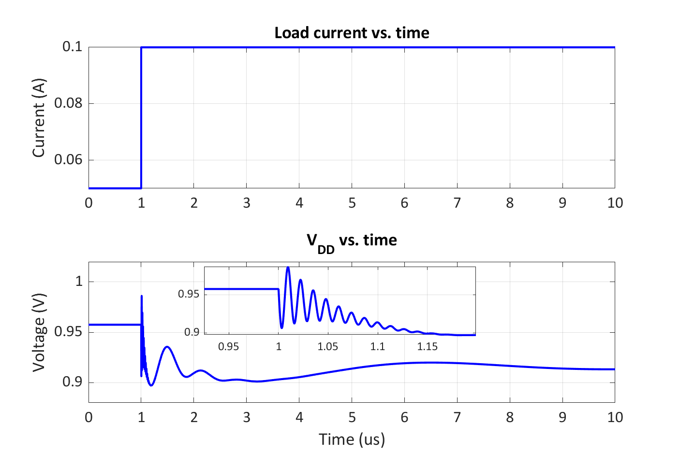
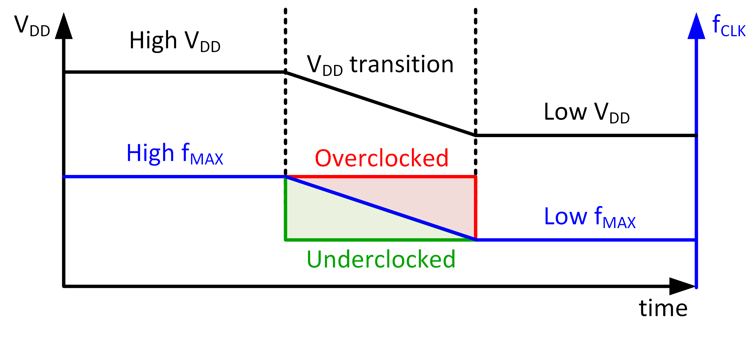
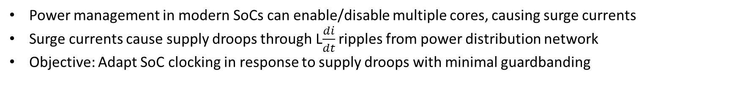
Motivation
Adapted from F. Ahmad et al. JSSC 2017
Adapted from T. Hashimoto et al. JSSC 2015
Power management in modern SoCs can enable/disable multiple cores, causing surge currents
Surge currents cause supply droops through L$\frac{di}{dt}$ ripples from power distribution network
Objective: Adapt SoC clocking in response to supply droops with minimal guardbanding

Slide 4
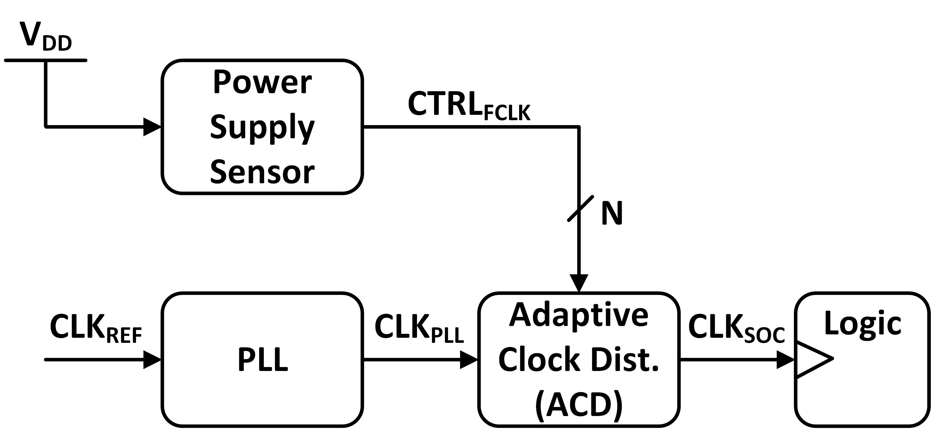
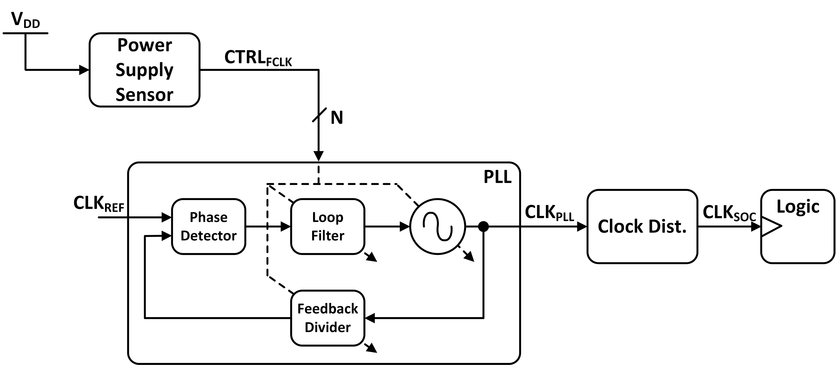
Adaptive Clocking Schemes
Power supply sensor detects V_{DD} change
Clock distribution (post-PLL) adjusts clock frequency by extending period
E.g. Phase rotators, tunable delay line
Power supply sensor detects V_{DD} change
PLL internally adjusted for frequency
E.g. direct override of VCO, loop filter, divider
Actuation latency (i.e. adaptation time) is a key metric

Slide 5
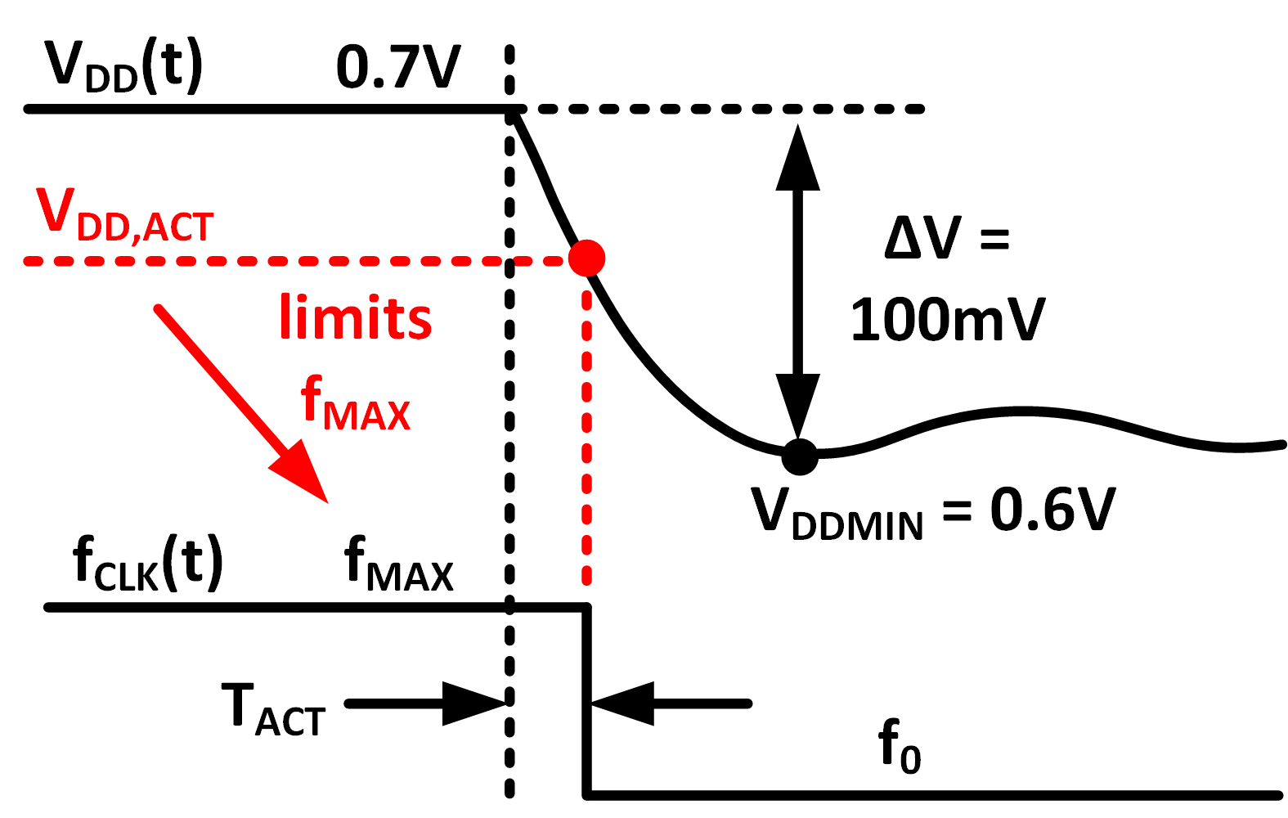
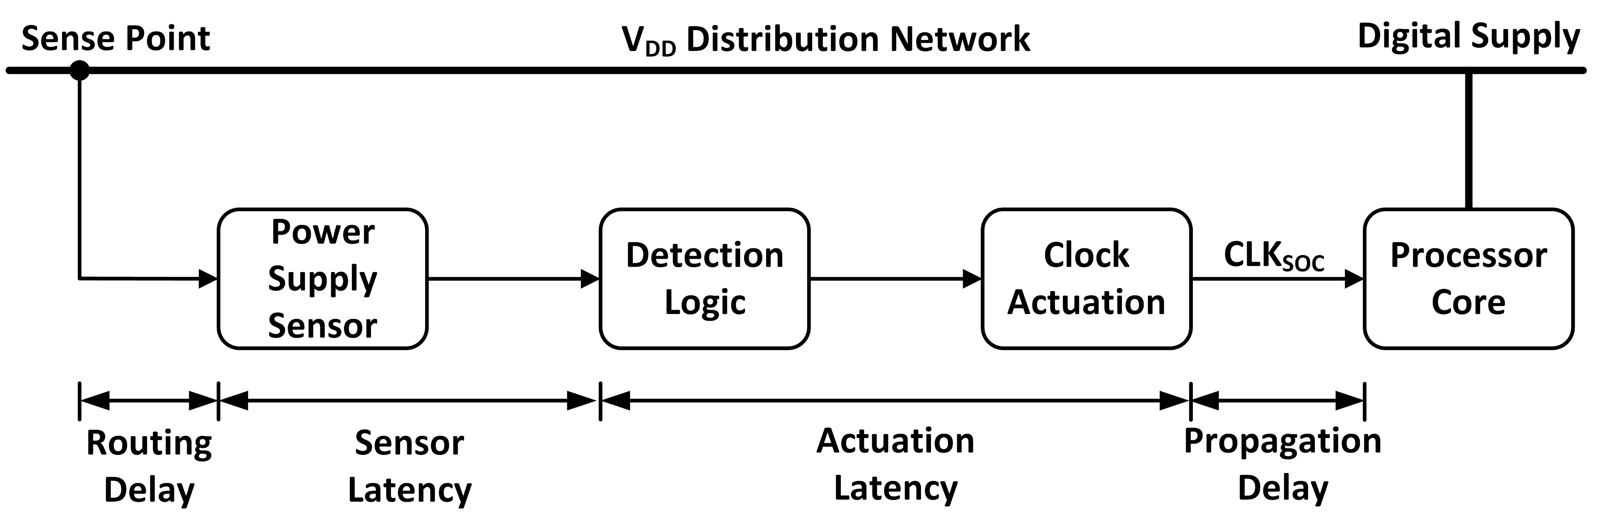
Actuation Latency Penalty
Longer T_{ACT} → lower V_{DD,ACT} → lower f_{MAX}
At fixed V_{DD}:
Longer T_{ACT} → lower V_{DD,ACT} → higher V_{MIN}
At fixed f_{MAX}:

Slide 6
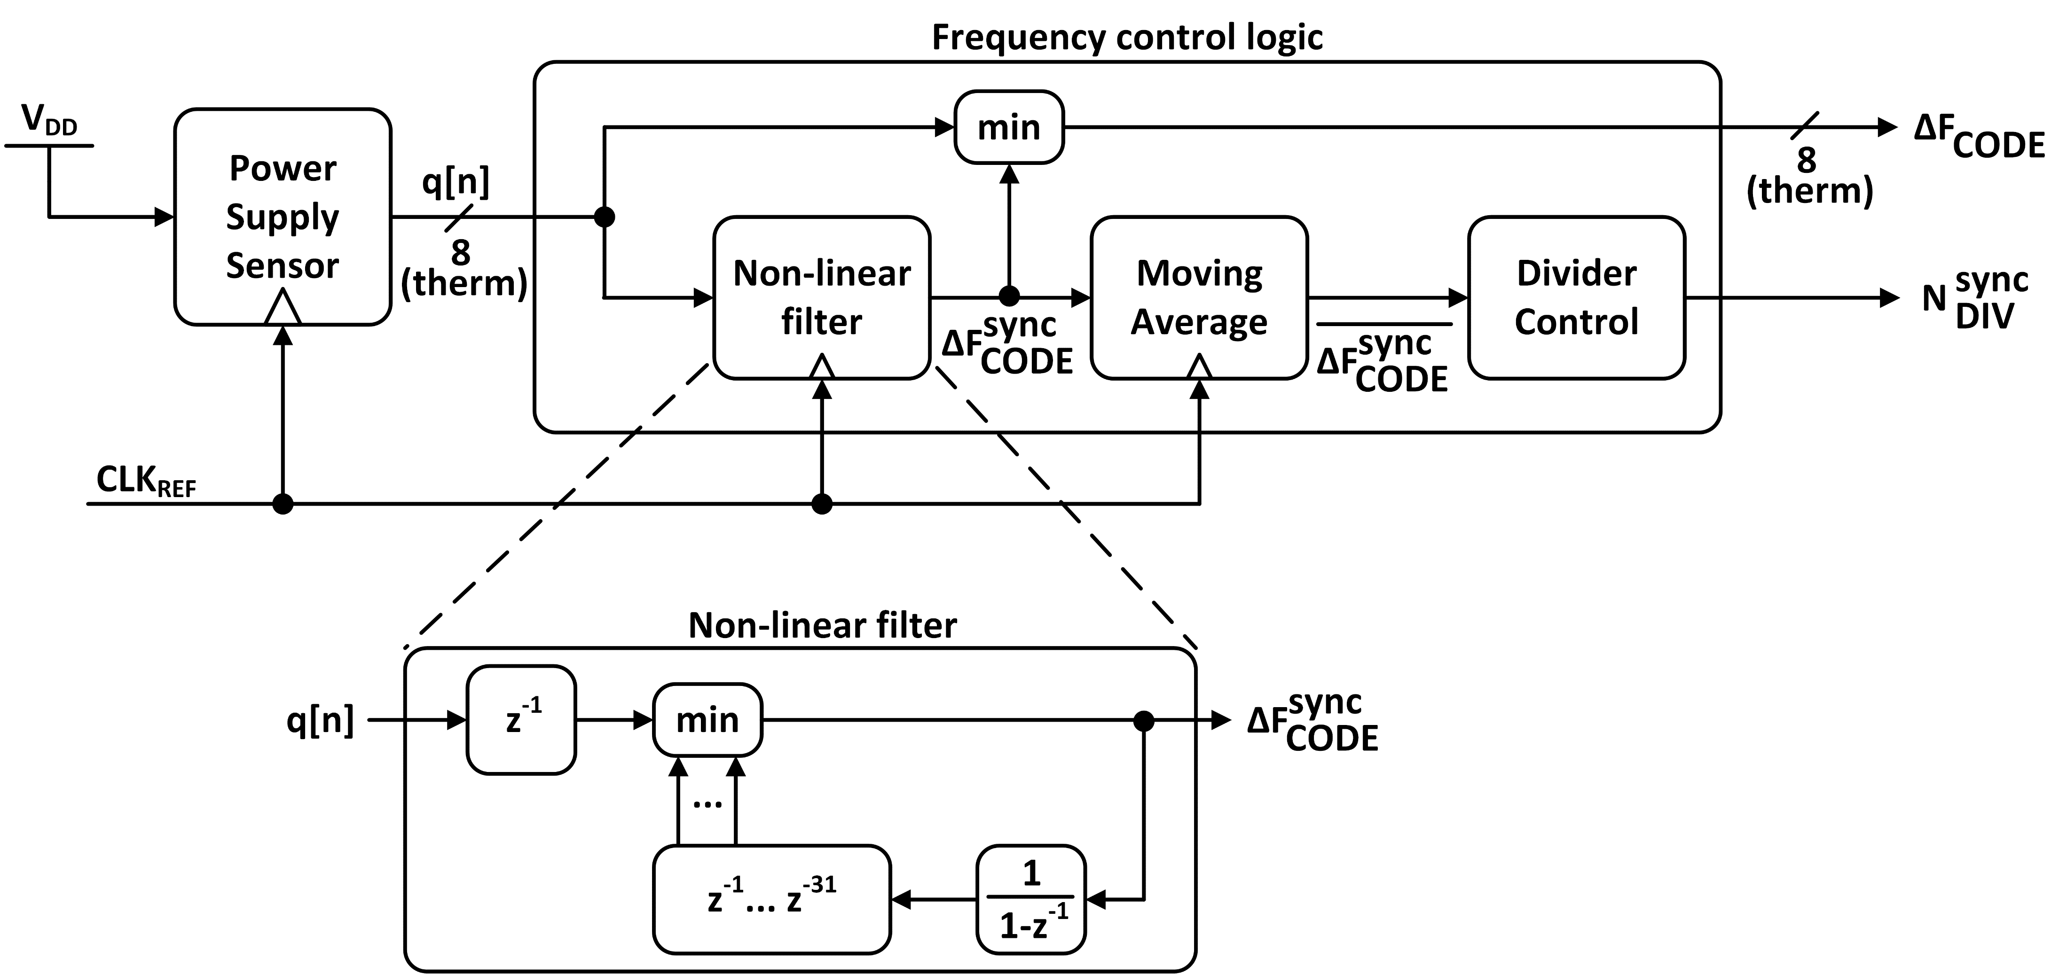
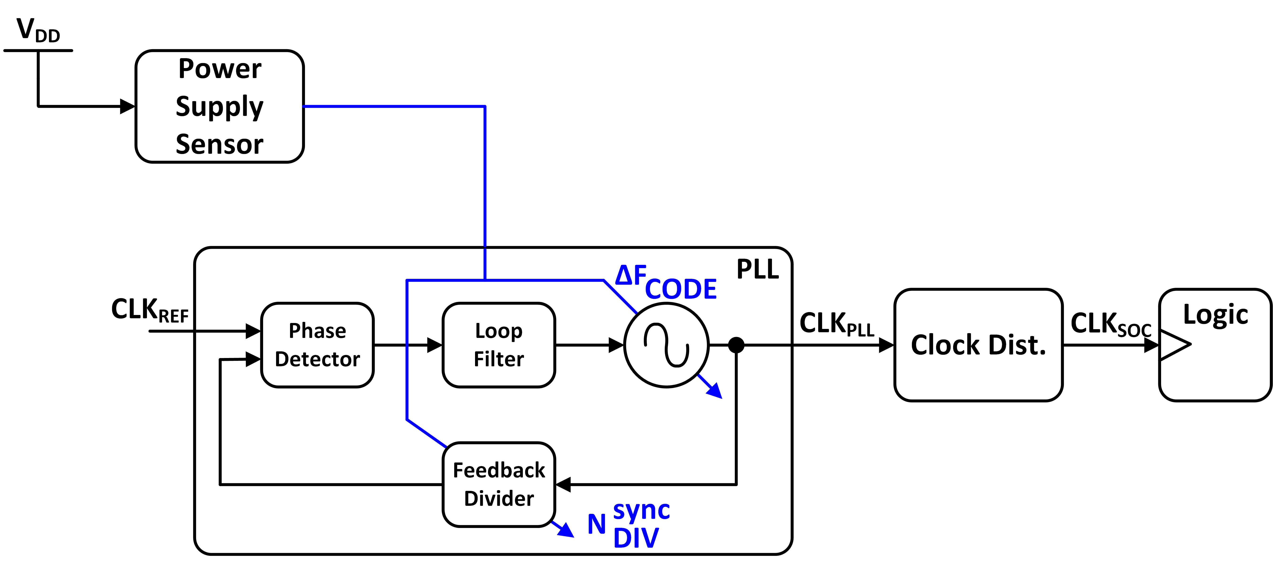
PLL-based adaptive clocking Hashimoto et al., JSSC 2015 (20nm CMOS)
ΔF_{CODE} immediately adjusts DCO in response to sudden droop
Sub-cycle logic latency + thermometer-coded logic (single AND gate)
N_{DIV}^{SYNC} filters droop through non-linear filter + moving average to track slower droops
Helps re-lock PLL to nominal frequency after droop event
Low-latency logic claimed to improve f_{MAX} by 7.5% (4.65GHz → 5.00GHz) or 5% V_{MIN} reduction at 4.65 GHz

Slide 7
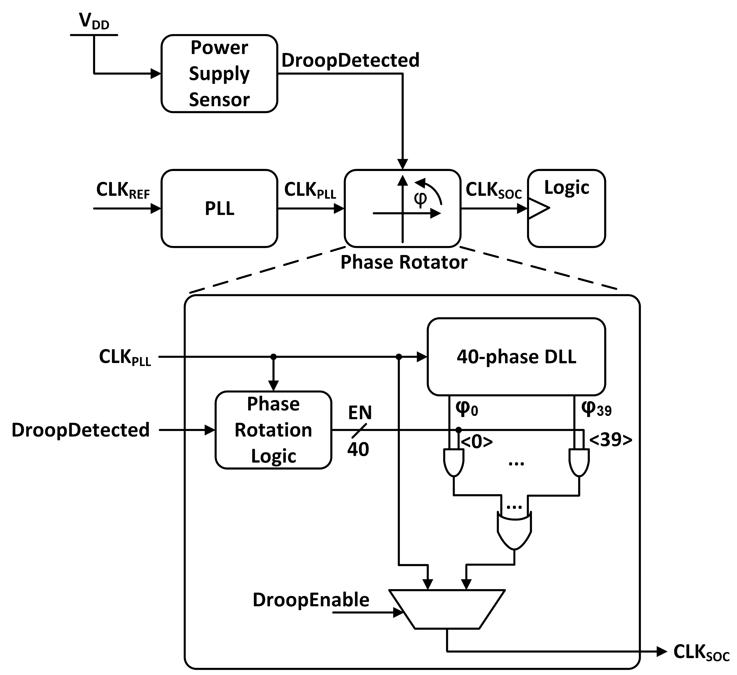
Adaptive clock distribution Wilcox et al., JSSC 2015 (28nm CMOS)
Phase rotator continuously extends period of CLK_{PLL} to generate lower-frequency CLK_{SOC}
40-phase DLL generates desired inputs to phase rotator mux
Longer actuation latency (3 clock cycles) than Hashimoto et al.
Up to 6% V_{MIN} reduction reported at 4 GHz

Slide 8
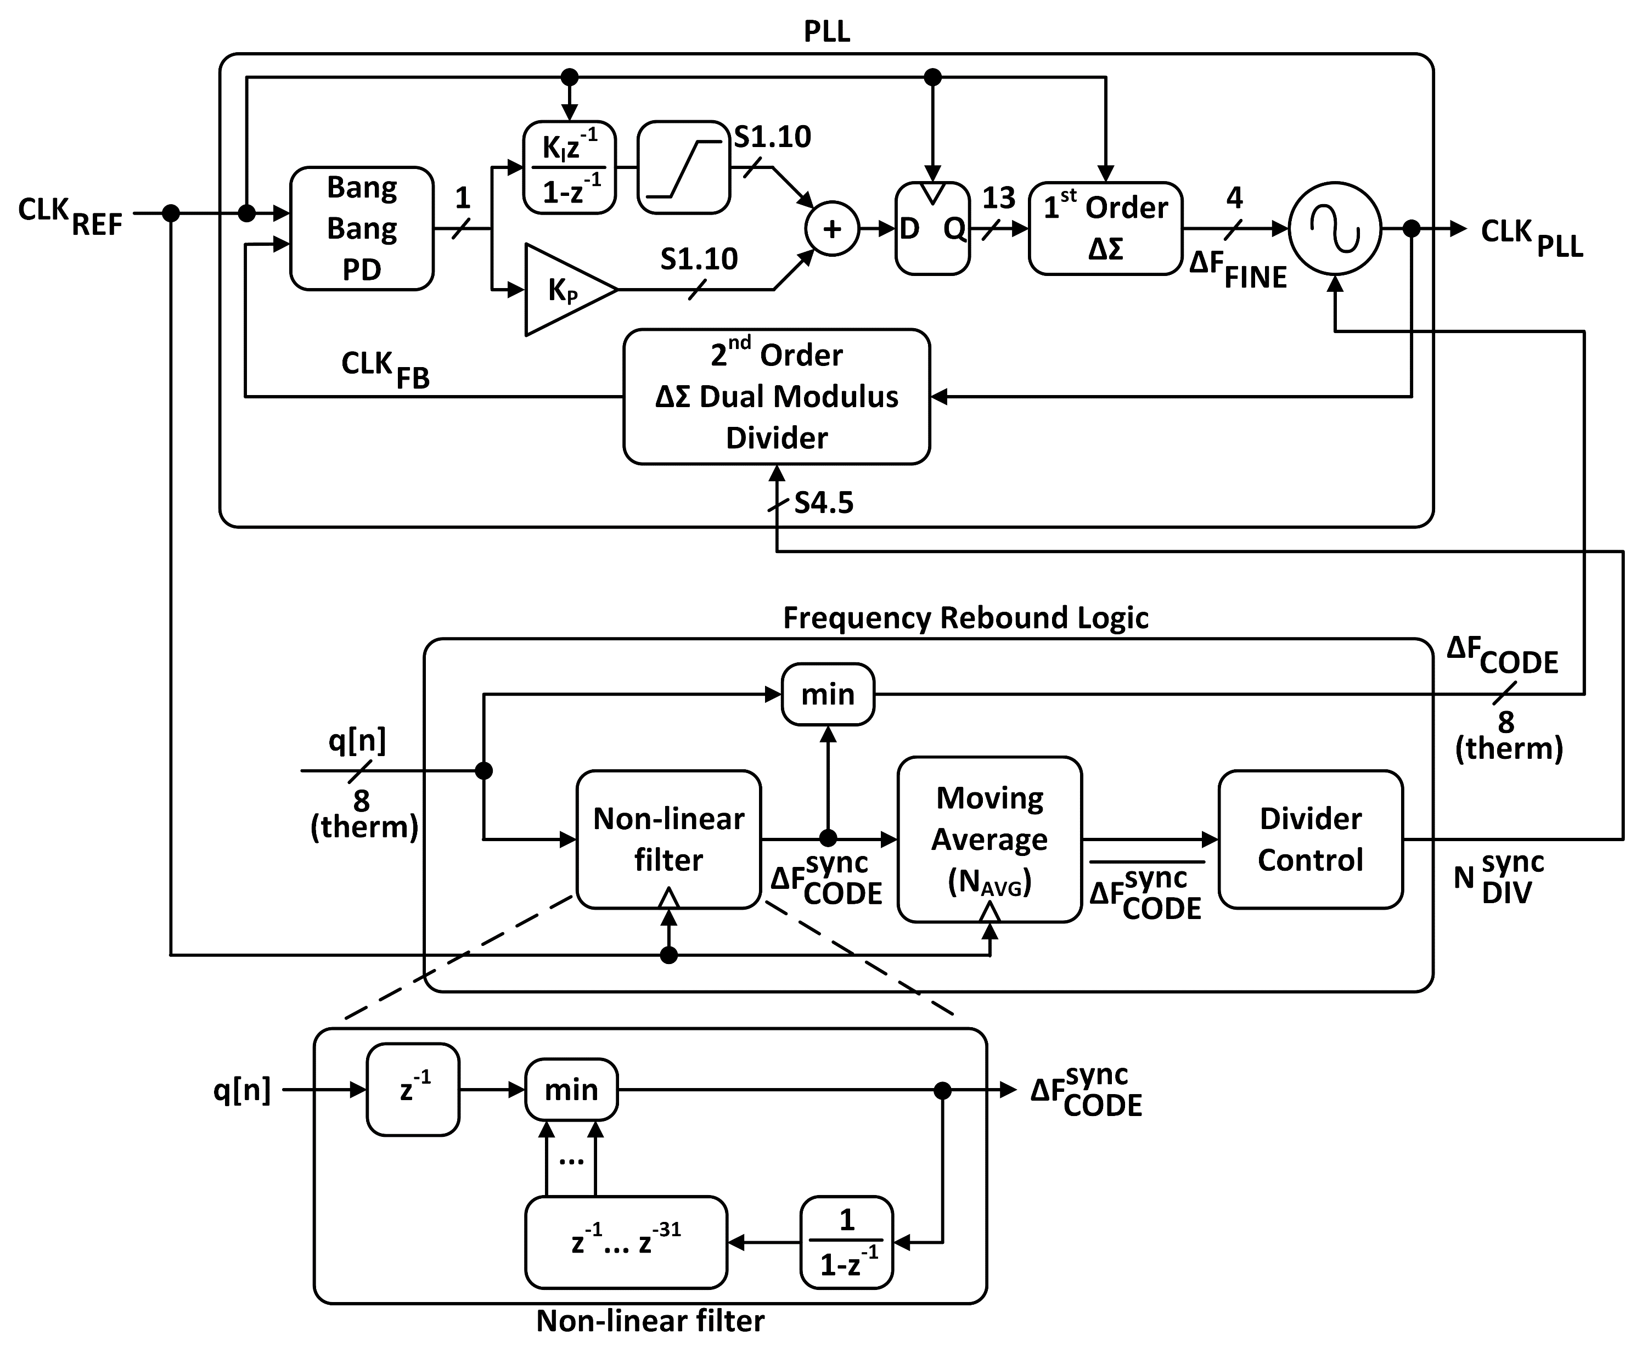
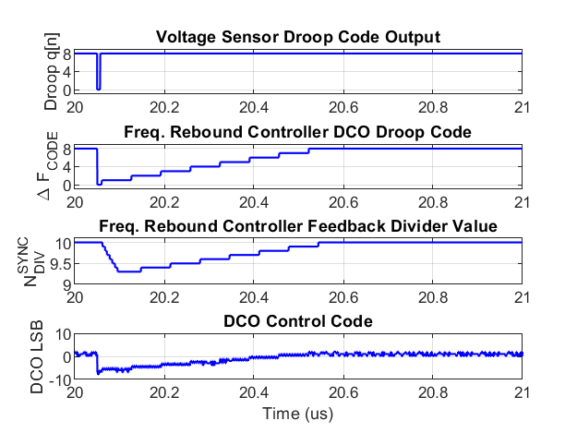
PLL-based adaptive clocking in ASAP7
K_{DCO} = 60MHz/LSB (from PEX)
K_{P} = 2⁰, K_{I} = 2⁻⁹
BW = 810kHz, PM = 79°
Logic latency = 40ps, DCO latency = 171ps (from PEX)
System-level simulation (MATLAB) with critical delays back-annotated from PEX

Slide 9
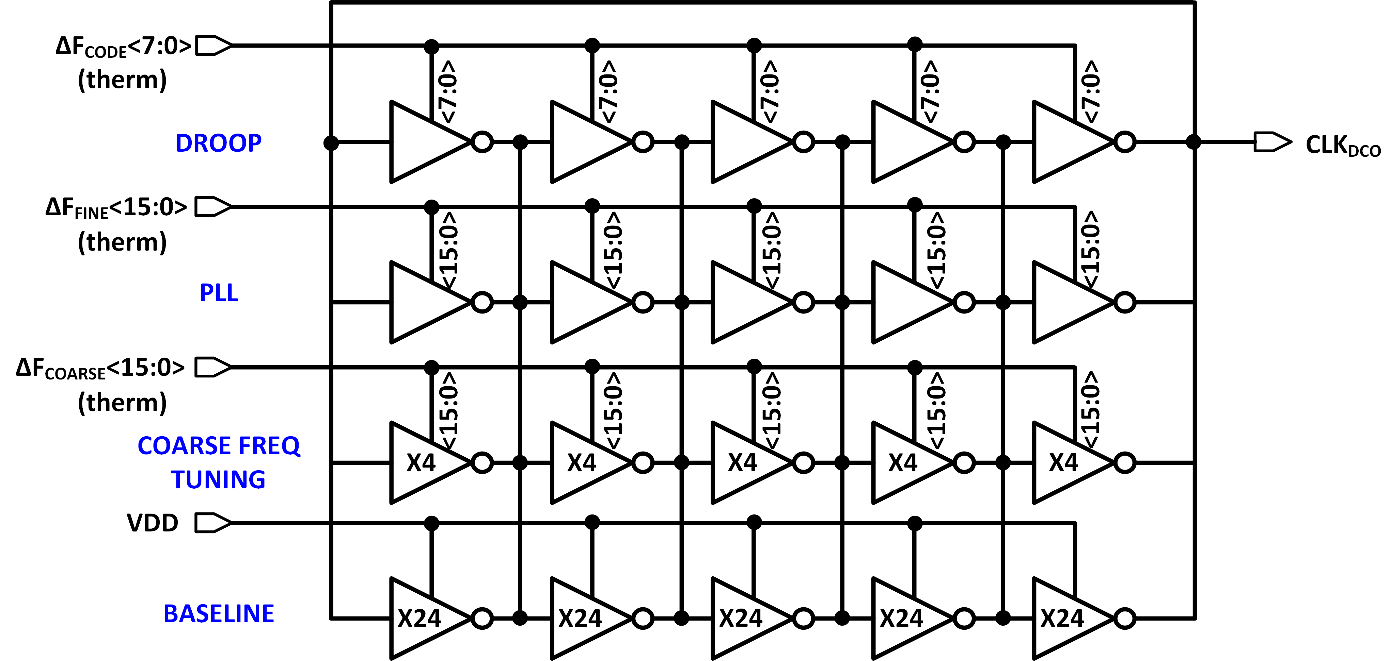
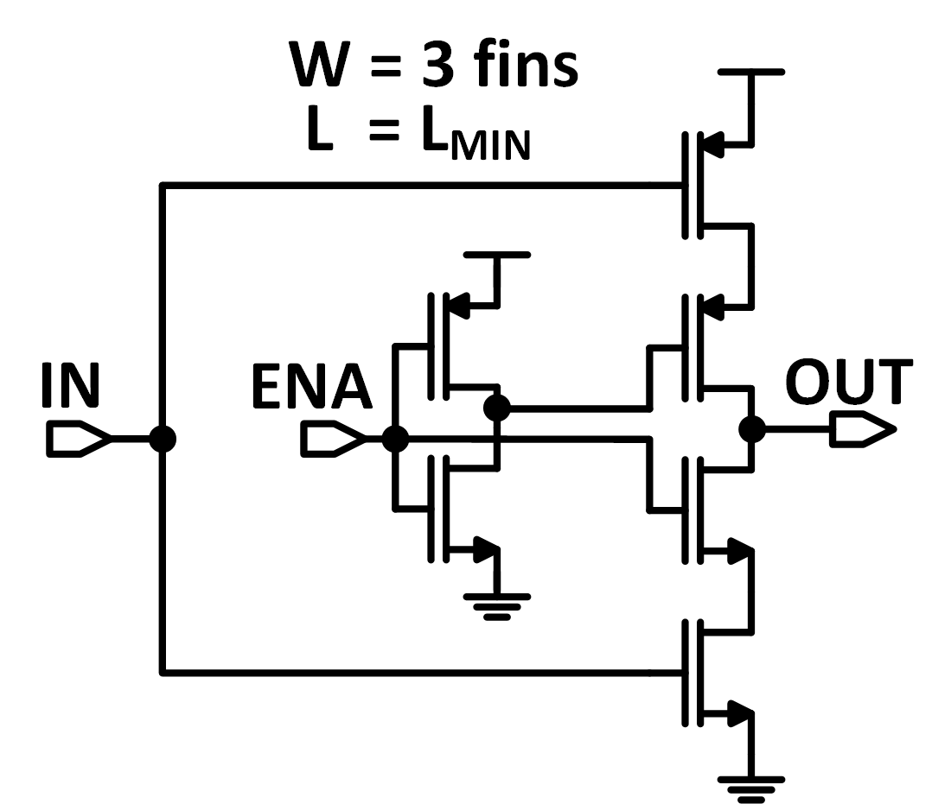
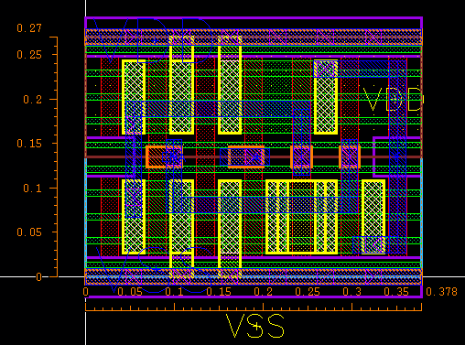
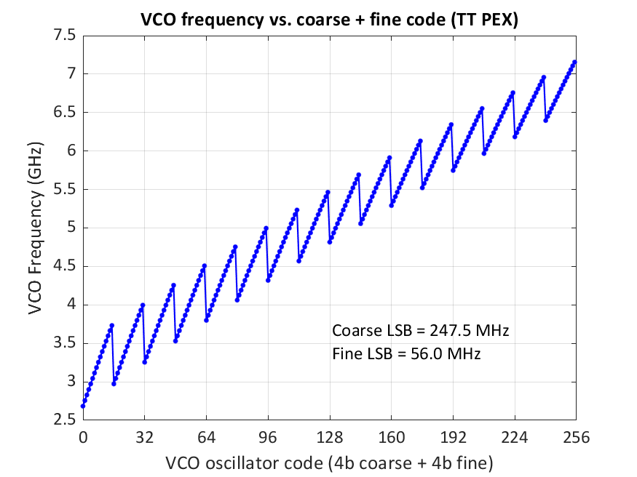
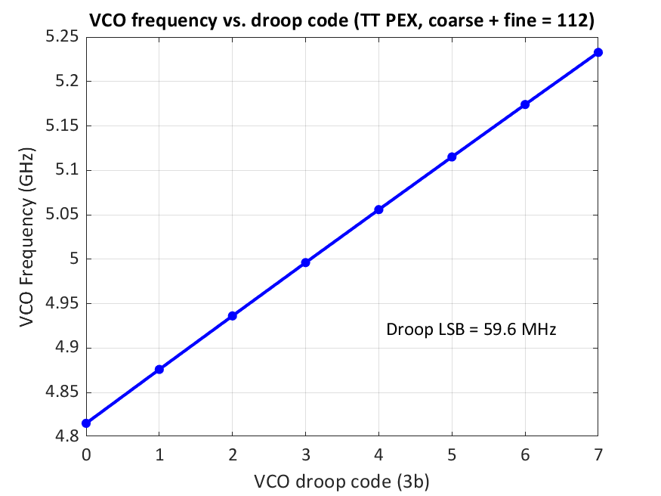
C2MOS DCO Implementation
4-bit coarse DAC (initial lock)
4-bit fine DAC (PLL)
3-bit droop DAC

Slide 10
RTL Implementation?

Slide 11
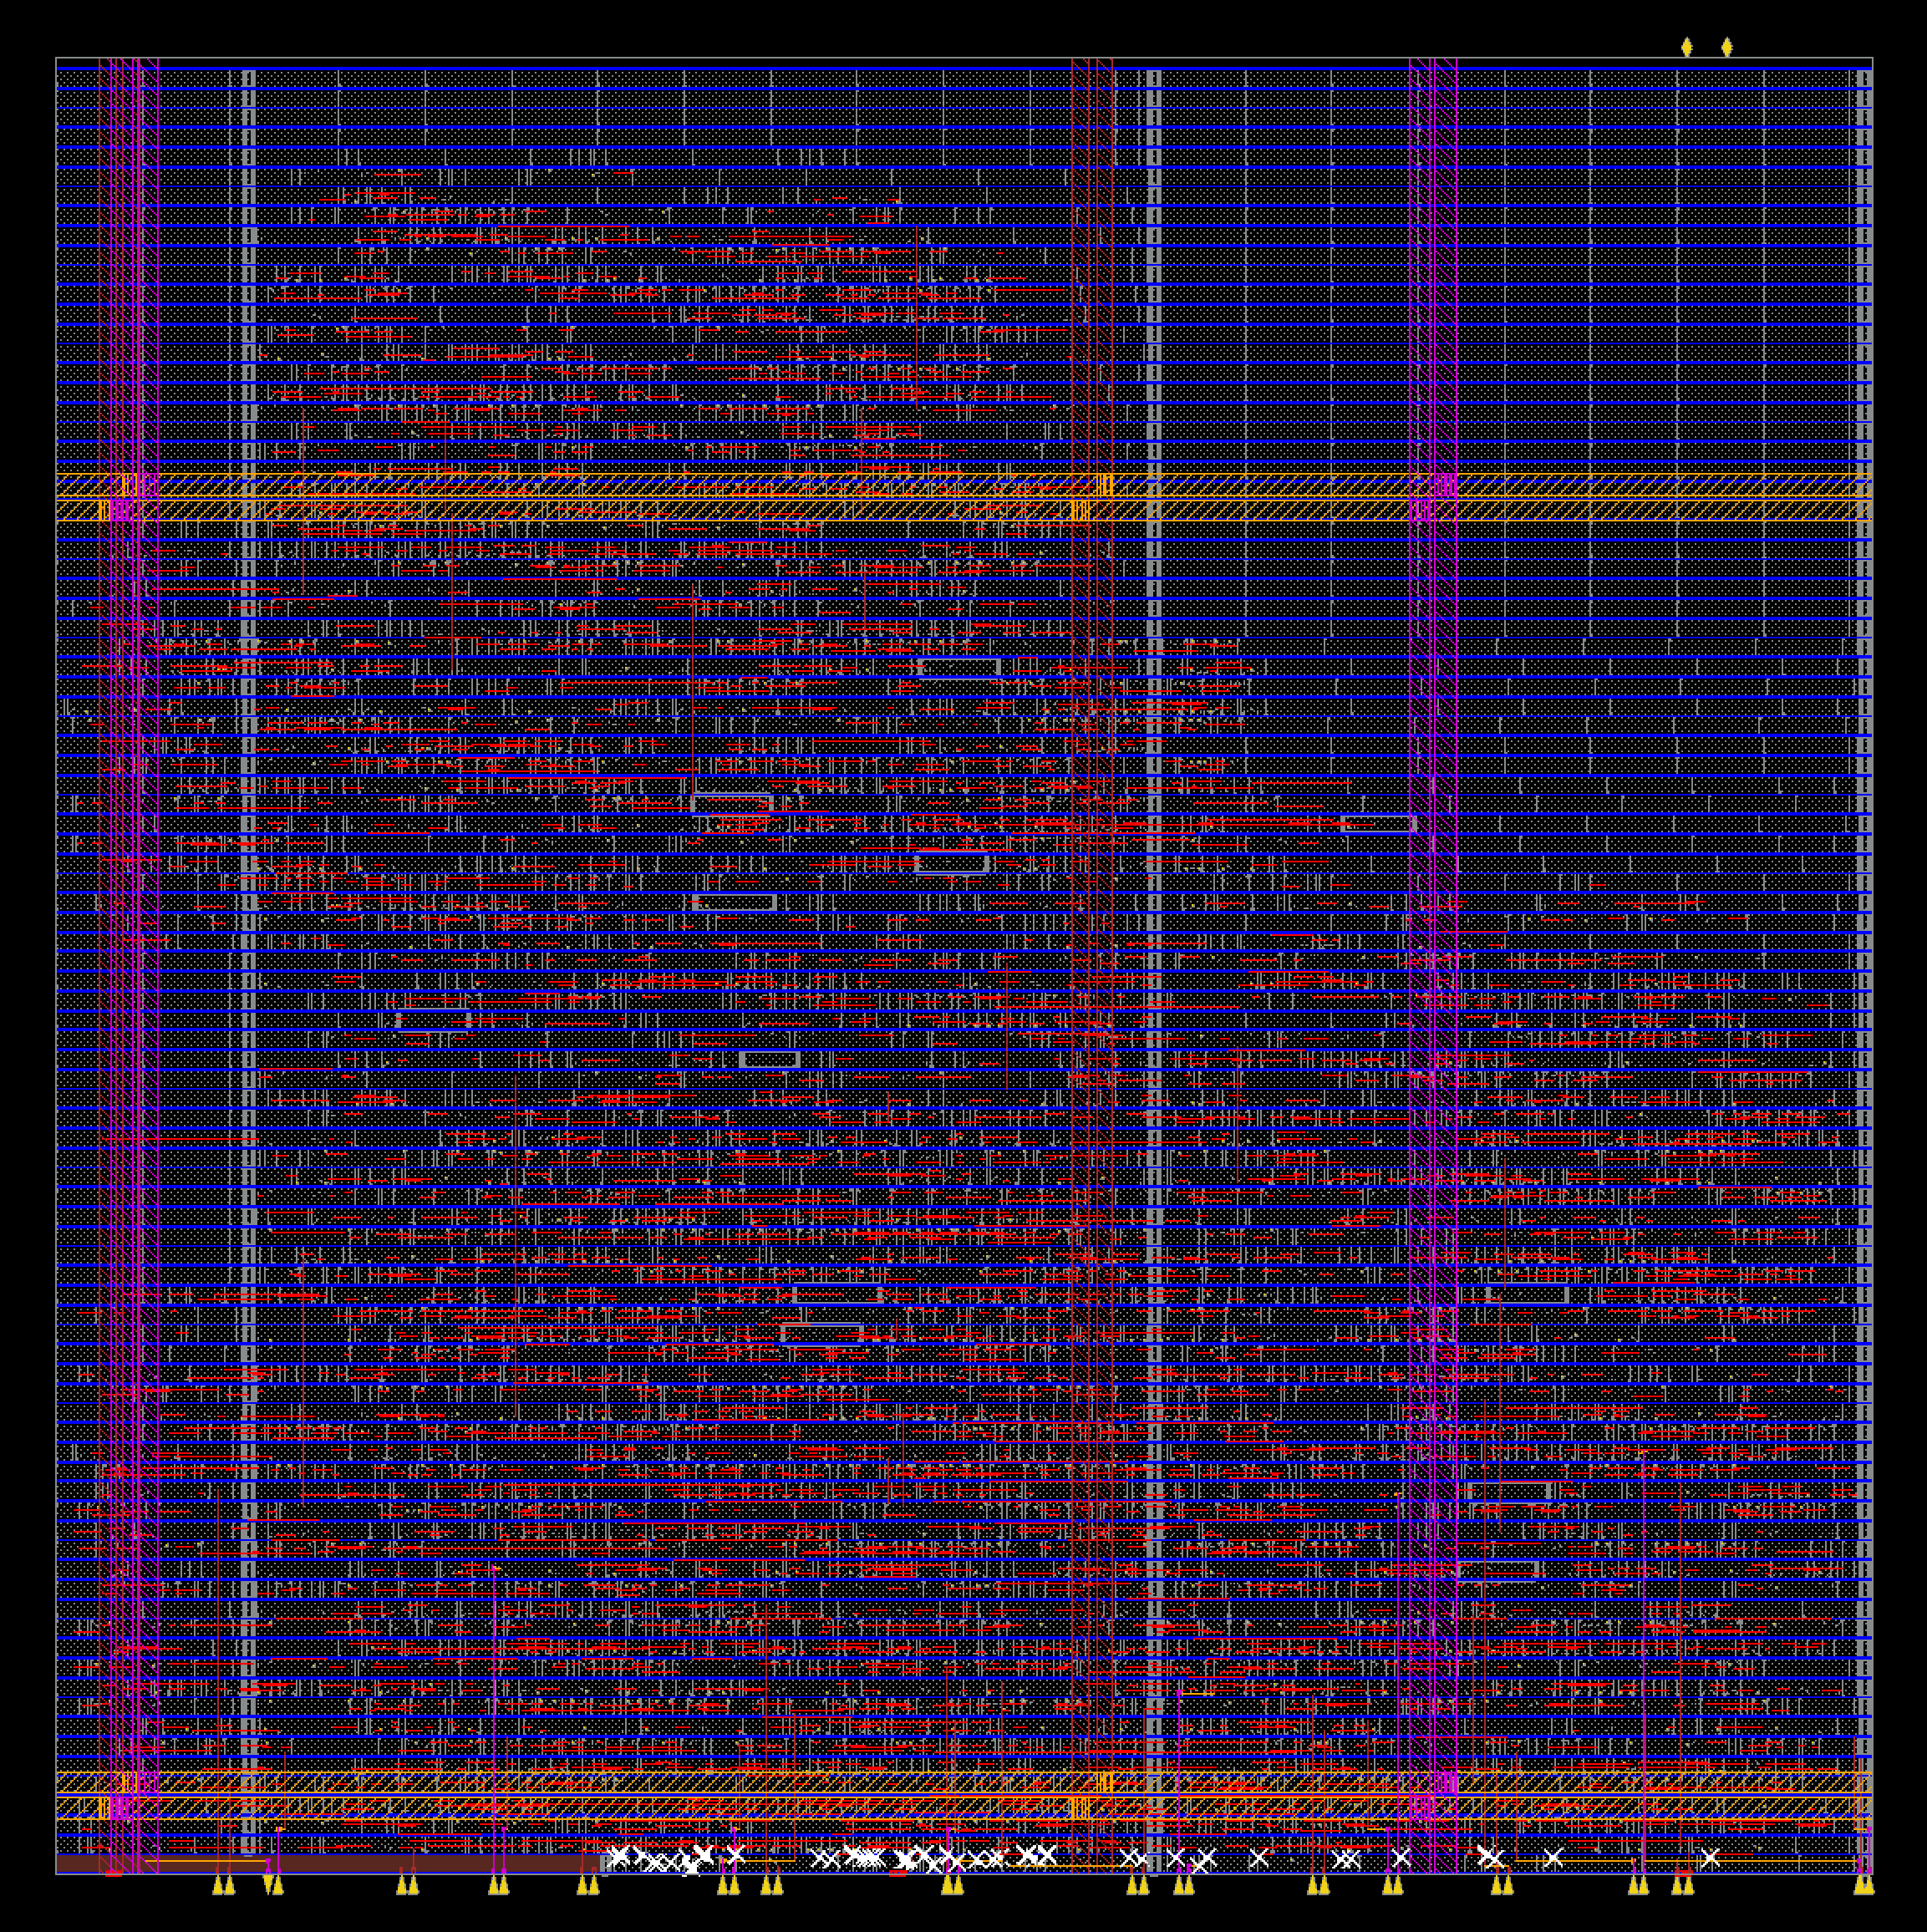
Backend implementation

Slide 12
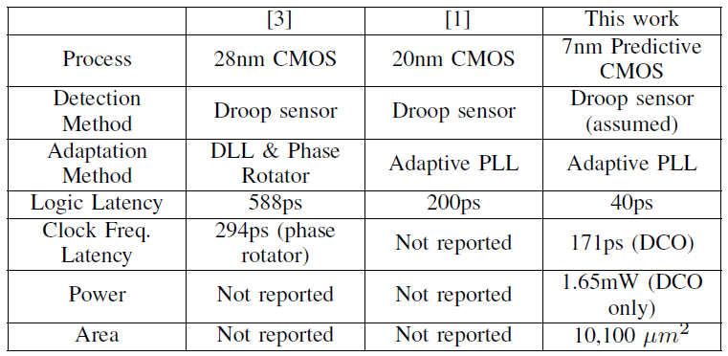
Comparison to Prior Works

Slide 13
Summary

